Slide 1
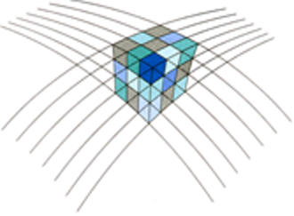
NLGEO2018
Wat krijgt de gebruiker aangeleverd
Bas Alberts
Rijkswaterstaat

Slide 2
NLGEO2018 – a new quasi-geoid
What changes (and what does not)?
NAP 0-level remains the same
Heights of NAP bench marks remain the same
But:
Improves height transformation between GNSS heights (ITRS/ETRS89) and NAP heights
Possible over a larger area

Slide 3
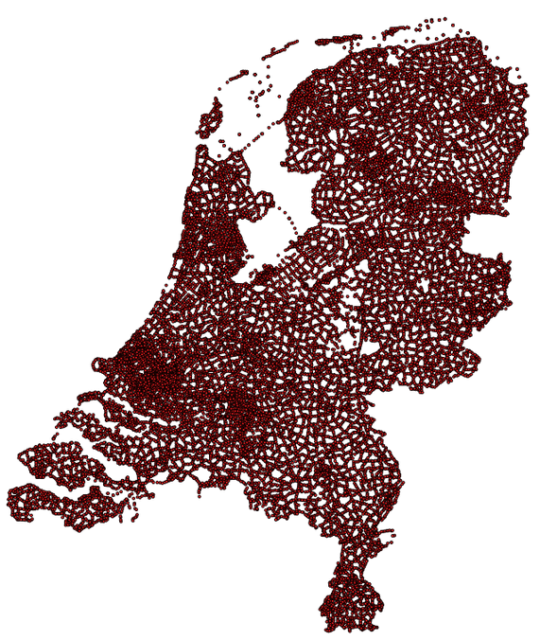
What is NAP?
Height network of bench marks
1st order and 2nd order network
Height information
NAPinfo
Height system
0 at average high tide of the IJ (1683-1684)
Purely leveled height system (no corrections for gravity)
Mean tidal system (no corrections for permanent tide effect)
Notes:
De 3 elementen van een GI

Slide 4
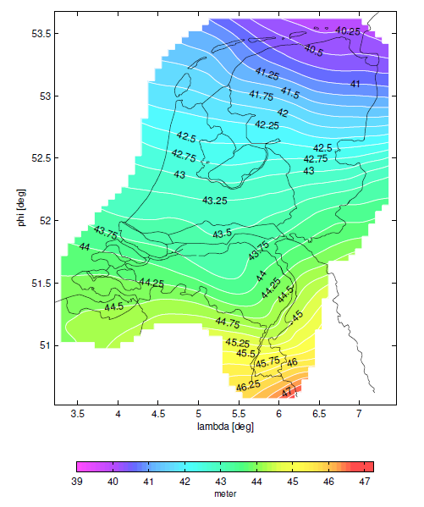
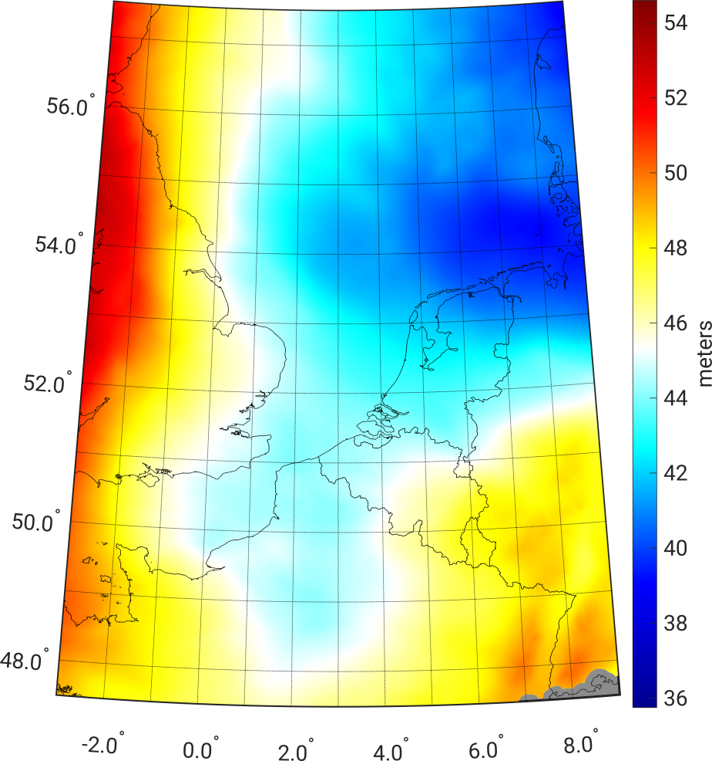
NLGEO2004 vs. NLGEO2018
Only valid on land
Valid on both land and sea
Notes:
Naast input data, satellietmodellen en berekeningsstrategie zijn er belangrijke verschillen

Slide 5
NLGEO2004 vs. NLGEO2018
Only valid on land
Implicit transformation of tide-free h to mean tide H
Valid on both land and sea
Exact computation of permanent tide effect (applied to NLGEO2018)

Slide 6
NLGEO2004 vs. NLGEO2018
Only valid on land
Implicit transformation of tide-free h to mean tide H
6-parameter corrector surface, fit to NWP5 GNSS leveling points
Valid on both land and sea
Exact computation of permanent tide effect (applied to NLGEO2018)
Corrector surface modeled by innovation function, fit to reprocessed NWP5 GNSS leveling points
H = h - (N+cor)
H = h - (N+tides+cor)
NLGEO2004
NLGEO2018

Slide 7
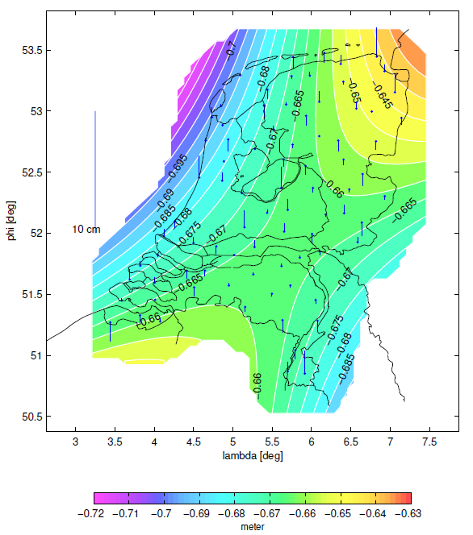
NLGEO2004 vs. NLGEO2018
Notes:
NLGEO2004: corrector surface +/- 65 cm: langgolvige fout in satellietmodel, nieuw corrector surface betere lokale fit.

Slide 8
NLGEO2004 vs. NLGEO2018
Only valid on land
Implicit transformation of tide-free h to mean tide H
6-parameter corrector surface
Connected to NWP5 GNSS leveling points
5’ x 3’ sampling, interpolation using Overhauser Splines
Valid on both land and sea
Exact computation of permanent tide effect (applied to NLGEO2018)
Corrector surface modeled by innovation function
Connected to NWP5 GNSS leveling points (reprocessed)
Dense sampling to allow for Bilinear interpolation

Slide 9
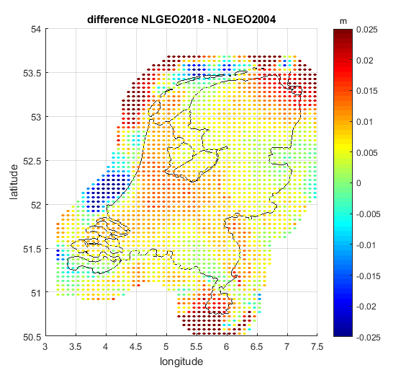
NLGEO2004 vs. NLGEO2018
Mean: 7.3 mm
→ Reprocessing GNSS leveling points NWP5
Notes:
Maar ook: andere realisatie ETRS89

Slide 10
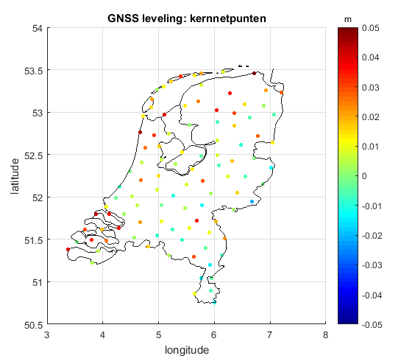
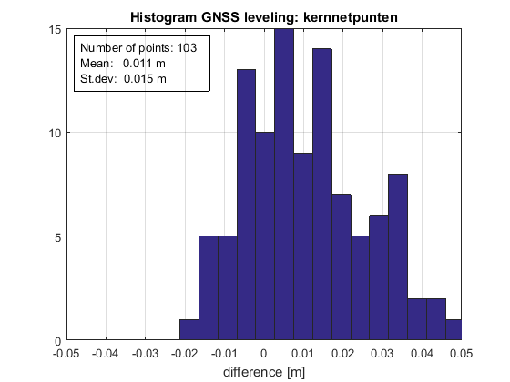
Validation
GNSS kernnet points
Short observation periods
NAP H en GNSS h not in same epoch
PMG network Prorail
(to be analyzed)
Dedicated campaign?

Slide 11
Deliverables
RDNAPTRANS: binary grid on Bessel
Grids in ETRS89 (ETRF2000(R14)) and/or ITRS (ITRF2014)
Sampling of NLGEO2018 grid and NLLAT2018 grid will be aligned
The grids will be made available on NSGI website (www.nsgi.nl) and the International Service for the Geoid (ISG) website

