Slide 1
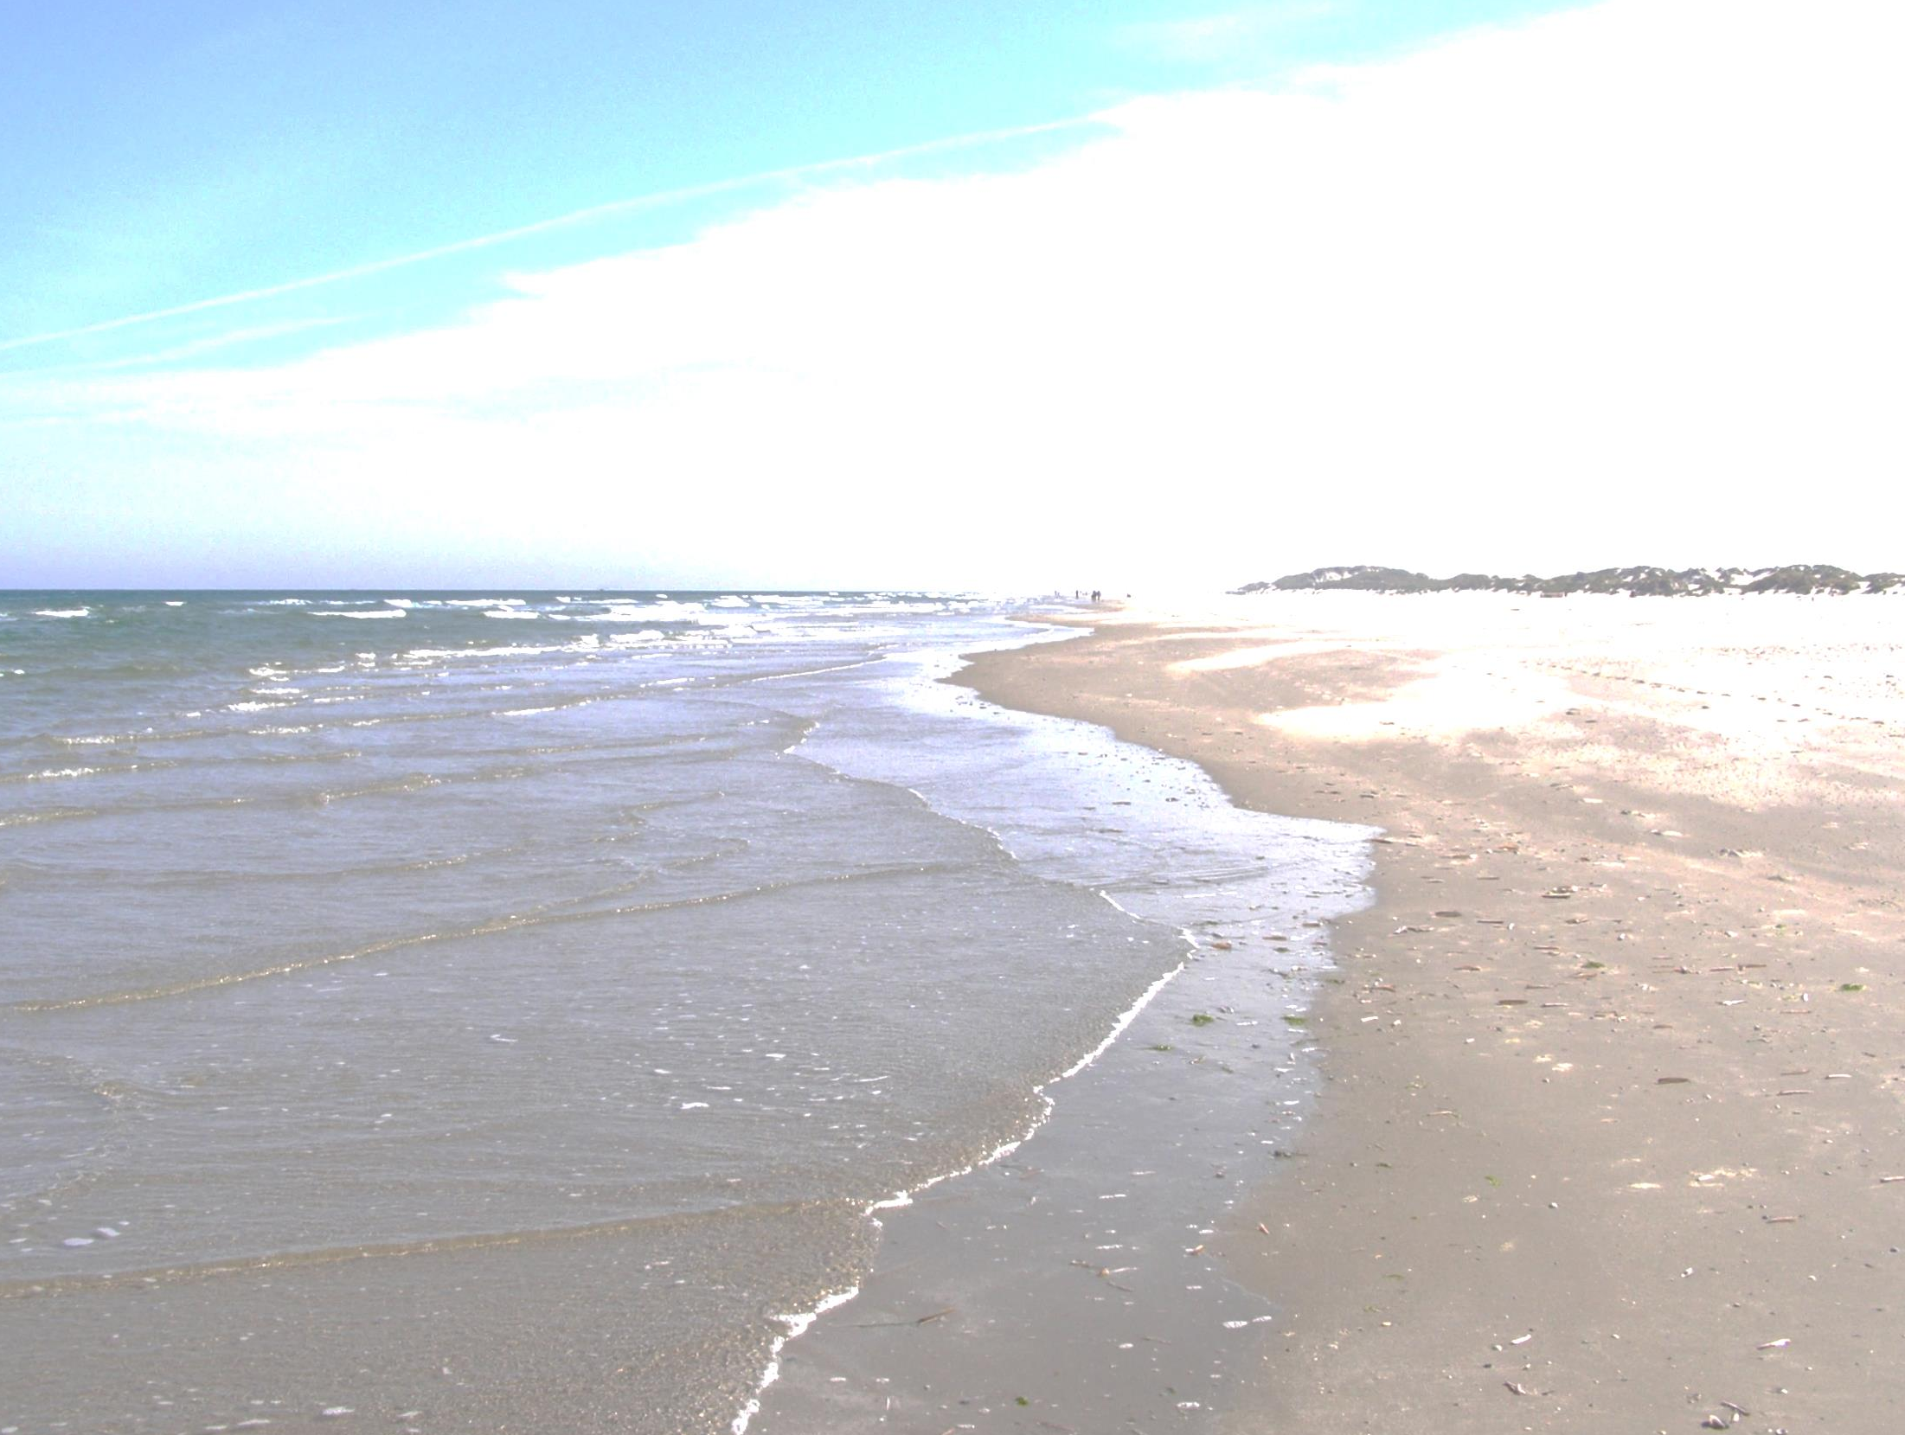
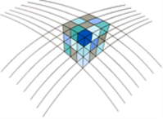
NEVREF Workshop
Voor de gebruikers van hoogtes en waterdieptes in Nederland
Welkom

Slide 2
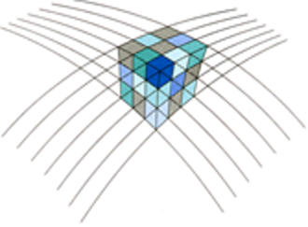
NEVREF project & onderzoeksteam
To obtain accurate realizations of the height and depth reference surfaces, including the necessary transformations from/to all common land and marine vertical reference surfaces
Hydrographic service
of Royal Navy
Rijkswaterstaat
Ministry of Infrastructure
and the Environment
Notes:
2

Slide 3
NEVREF gebruikersgroep
Hydrographic service
of Royal Navy
Rijkswaterstaat
Ministry of Infrastructure
and the Environment
Notes:
3

Slide 4
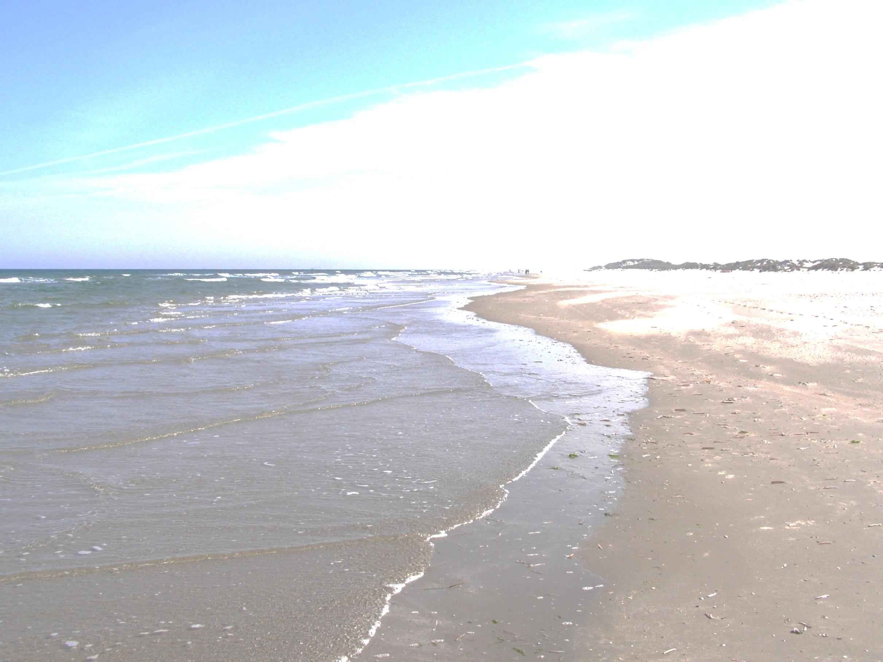
Programma
13:40 | NAP, geoïde, quasi-geoïde, Lowest Astronomical Tide, enz. – hoe zat het ook al weer? Prof. Dr.-Ing. habil. Roland Klees, TU Delft, projectleider NEVREF
13:55 | NLGEO2018 & NLLAT2018 – berekeningsstrategie en nauwkeurigheid Dr. Ir. Cornelis Slobbe, TU Delft
14:20 | Van ellipsoïdische hoogte naar NAP hoogte/diepte t.o.v. LAT – waar een gebruiker op moet letten Ir. Lennard Huisman, Kadaster
14:45 | Pauze
15:05 | NLGEO2018/NLLAT2018 – wat krijgt de gebruiker aangeleverd Dr. Ir. Bas Alberts, Rijkswaterstaat / Ing. Rogier Broekman, Dienst der Hydrografie
15:45 | Heighting across borders – the European context Dipl.-Ing. M. Sacher, Bundesamt für Kartographie und Geodäsie
16:10 | Pitches
16:40 | Forum discussie: op naar 2028! Het NEVREF team
17:00 | Afsluiting Prof. Dr.-Ing. habil. Roland Klees, TU Delft, projectleider NEVREF
Notes:
Fugro 5-10 min (door Ward Stolk)
Deltares 15-20 min (door Martin Verlaan)
Cornelis 5 min
Roland 5 min

Slide 5
NAP, geoïde, quasi-geoïde, Lowest Astronomical Tide, enz.
– hoe zat het ook al weer ?
NEVREF research team

Slide 6
NAP height
P₁
crust
ΔH
P₀
NAP height
?
?
NAP
?
?
?
zero NAP height
Notes:
6

Slide 7
NAP height and ellipsoidal height
P₁
crust
ellipsoidal height
NAP height
NAP
zero NAP height
quasi-geoid
quasi-geoid height
ellipsoid
NAP height = ellipsoidal height – quasi-geoid height
Notes:
7

Slide 8
NAP referentievlak, geoid, and quasi-geoid
P₁
crust
normal
height
orthometric height
NAP
NAP height
zero NAP height
geoid
quasi-geoid
Notes:
8

Slide 9
Sun & Moon: the tides
crust
NAP height = ellipsoidal height – quasi-geoid
height
NAP height
ellipsoidal
height
quasi-geoid height
quasi-geoid
ellipsoid
Notes:
9

Slide 10
Sun & Moon: the tides
crust
quasi-geoid
Notes:
10

Slide 11
Sun & Moon: the tides
tide-free crust
mean-tide
crust
NAP height
tide-free quasi-geoid
zero-tide quasi-geoid
mean-tide quasi-geoid
NAP height = mean-tide ellipsoidal height
– mean-tide quasi-geoid height
Notes:
11

Slide 12
Corrected quasi-geoid heights to support levelling with GPS
mean-tide
crust
GPS/levelling point
NAP
zero NAP height
mean-tide quasi-geoid
NAP height = mean-tide ellipsoidal height – corrected mean-tide quasi-geoid height
Notes:
12

Slide 13
Depth reference surface
Lowest Astronomical Tide (LAT) … is defined as the lowest (…) tide level which can be predicted to occur under average meteorological conditions and under any combination of astronomical conditions …
Notes:
13

Slide 14
The Lowest Astronomical Tide reference surface
Mean-tide crust
land
sea
NAP height
MSL
zero NAP height
LAT
mean-tide quasi-geoid
ellipsoidal
height of LAT
mean-tide quasi-geoid height
ellipsoid
Notes:
14

